Slide 1

POWER MEETS PRECISION
POWER MEETS PRECISION
A PRESENTATION TO [INSERT CLIENT]
Presentation for visiting schools
Update 06/2016

Slide 2
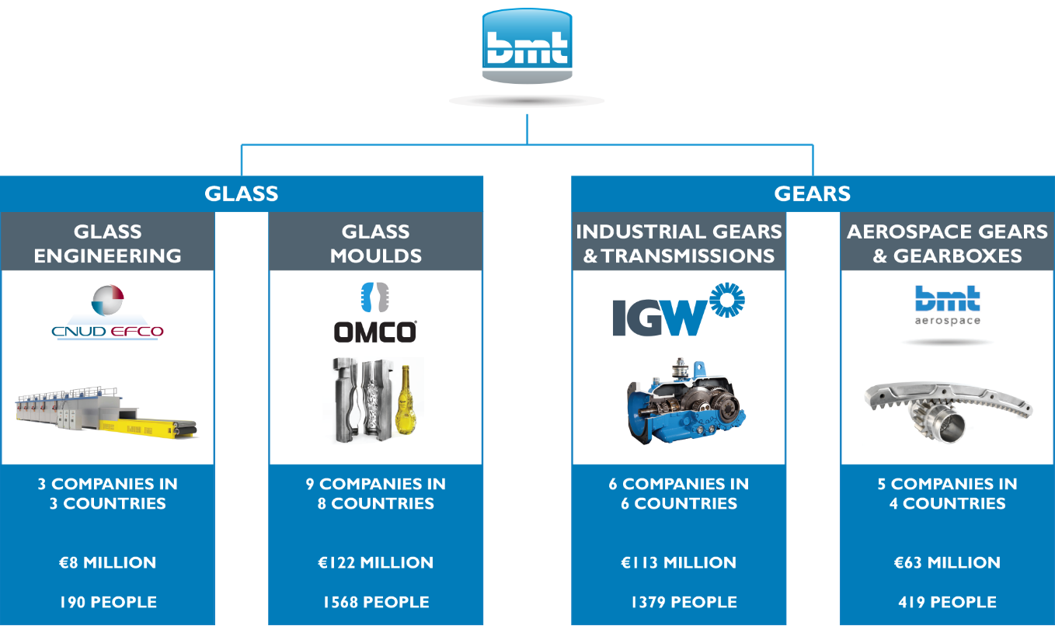
PART OF BMT GROUP
Source: BMT annual report 2015
Notes:
STEEKT BLAUW BMT GROUP KADERS NIET TE VEEL AF TOV BANNER ONDERAAN IN IGW BLAUW?

Slide 3
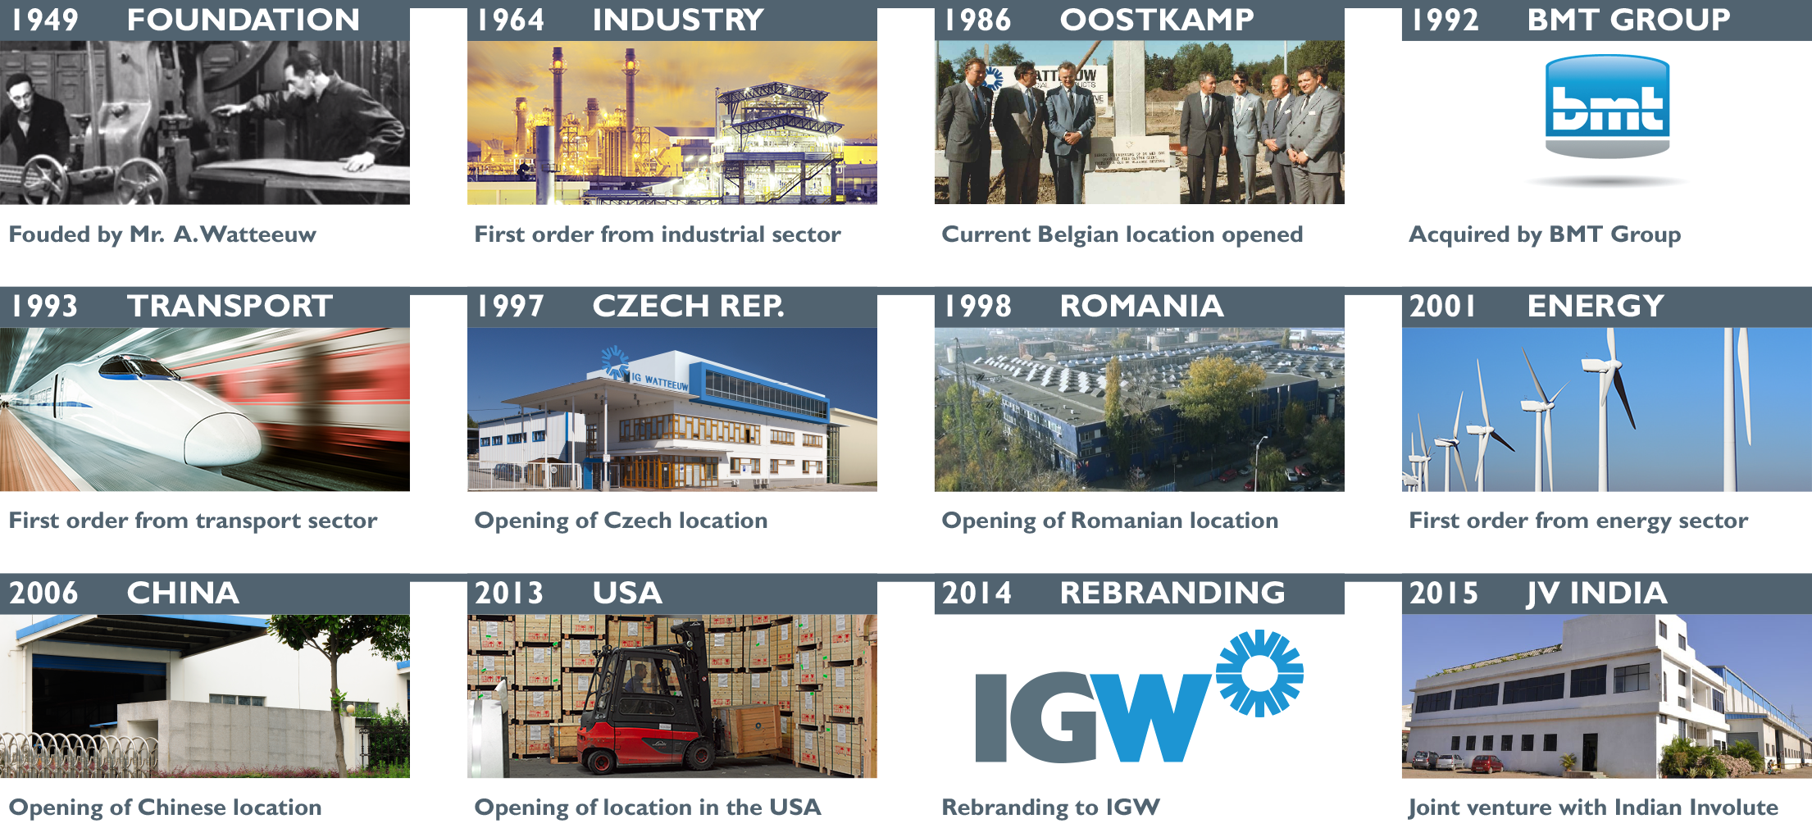
MILESTONES

Slide 4

OUR MISSION & VISION
MISSION & VISION

Slide 5
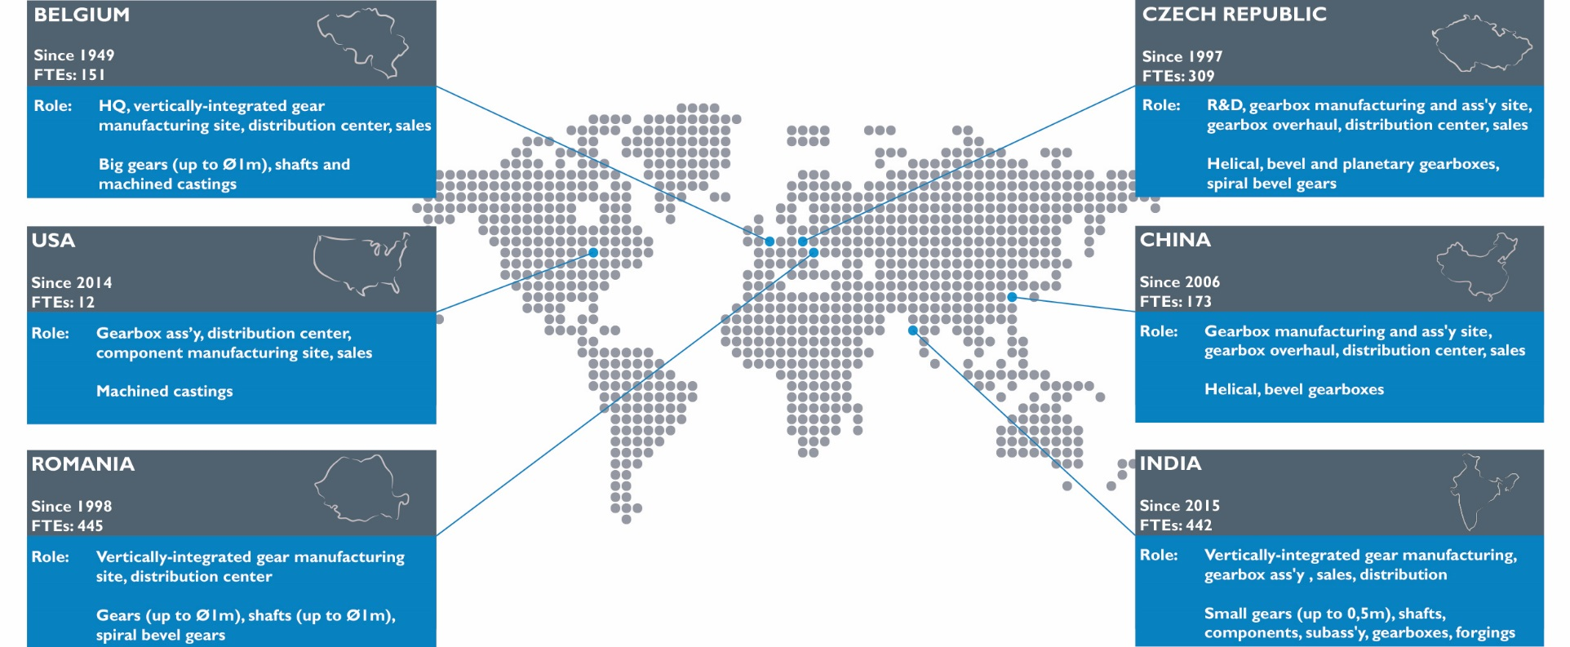
GLOBAL PRESENCE

Slide 6

VALUE PROPOSITION

Slide 7

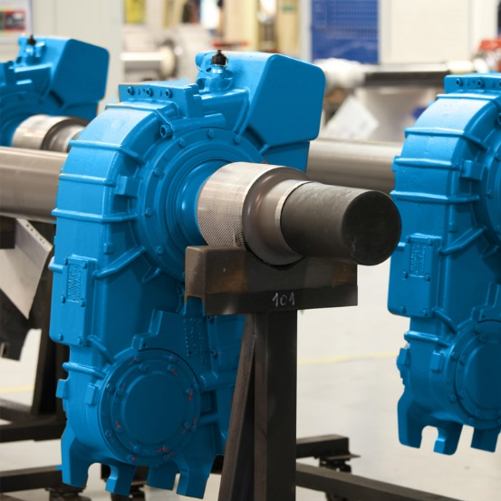
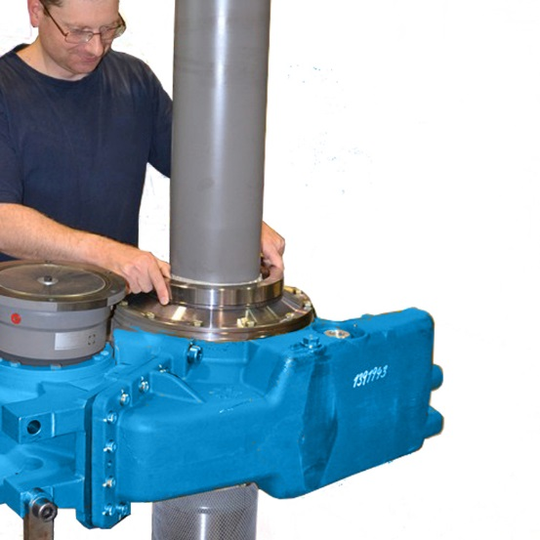
OUR PRODUCTS
Gears
GEARBOXES
SERVICES

Slide 8


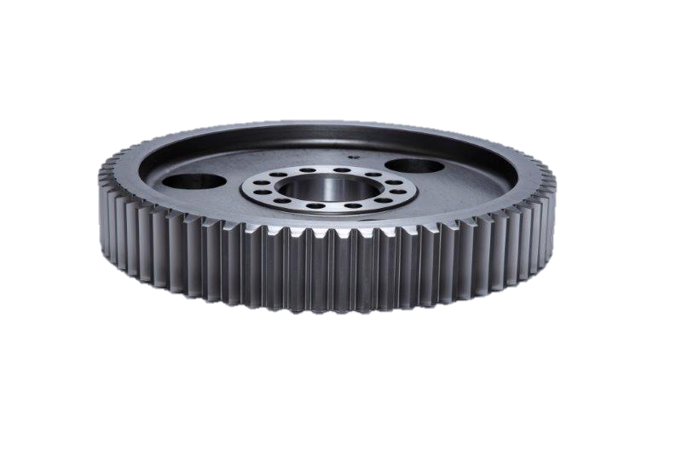

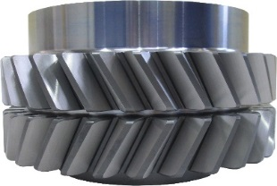
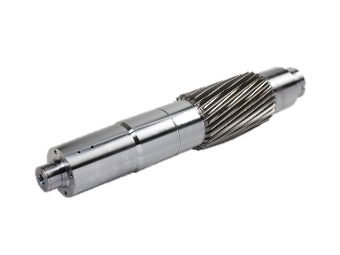

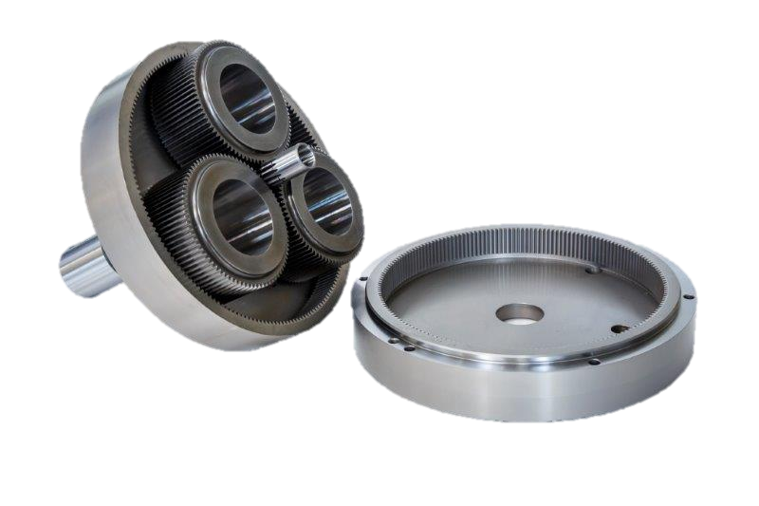
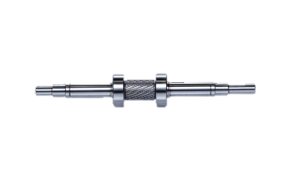
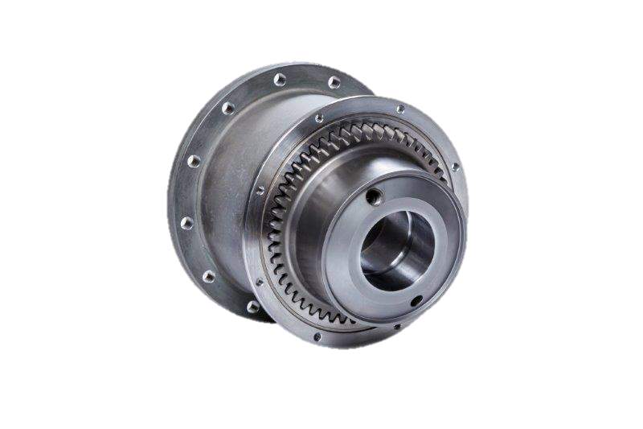
GEARS
L 2.500mm / 100”
Spur Gears
Helical Gears
Gear Ass’y
Double Helical Gears
Spiral Bevel gears
Gear shafts
Planetary Gear Sets
Pinions
Gear Couplings
Gear & Shaft Ass’y
∅ 25mm / 1”
∅ 2.000mm / 80”

Slide 9
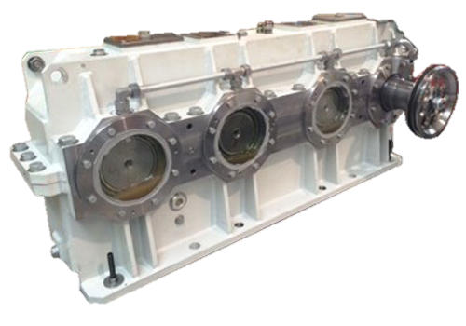
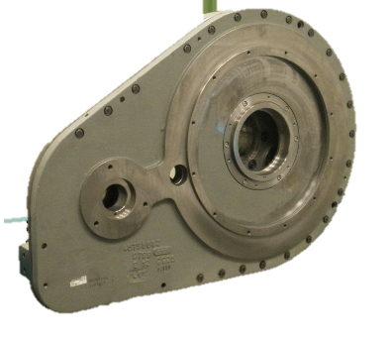


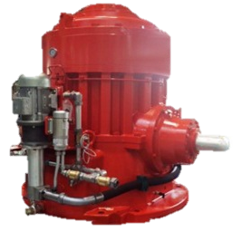
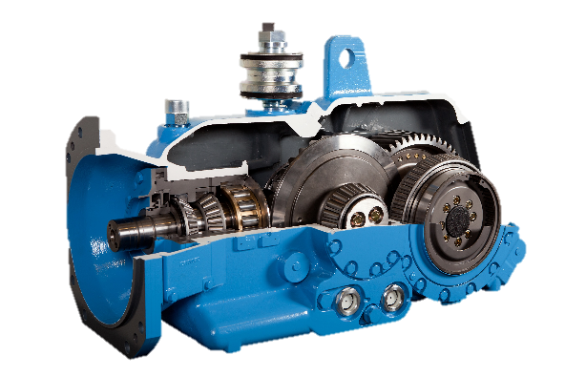

GEARBOXES
PTO Ass’y
Helical / Bevel & Spur Gearbox
Double Planetary Gearbox
Helical Summation Gearbox
2-stage Bevel Helical Gearbox
2-stage Helical Gearbox
Planetary Gearbox

Slide 10



SEGMENTATION
Transport
Energy
INDUSTRY

Slide 11



MAIN APPLICATIONS

Slide 12
KEY FIGURES
SALES EVOLUTION

Slide 13
COMMITMENT TO QUALITY

Slide 14




































SOME REFERENCES

Slide 15

AT A GLANCE

Slide 16
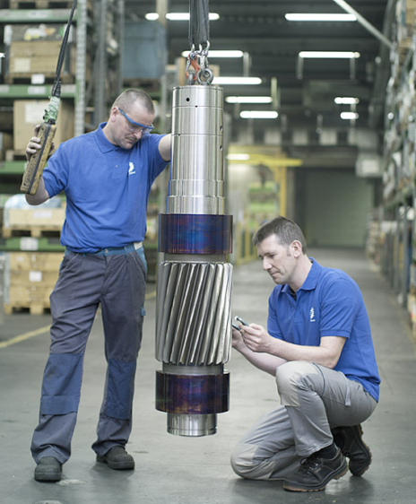
WORKING AT IGW
Be part of an expert team
With highly trained employees
Using the state-of-the-art manufacturing techniques
In a global, open and self-learning organization

Slide 17

WORKING AT IGW
Long continuous cooperation with a lot of schools and universities
Growing organization with a great reputation
Grow your own skills and competencies

Slide 18
CONTACT OUR HR DEPARTMENT!
  hr.romania@IGWpower.com
  +40 374 100 243

Slide 19

Setting the standards for years to come
www.IGWpower.com info@IGWpower.com
IGW Belgium
IG Watteeuw International nv
Kampveldstraat 51
8020 Oostkamp
BELGIUM
T +32 50 82 69 07
IGW Czech Republic
IG Watteeuw
ČR sro
Vídeňská 130
61900 Brno
CZECH REPUBLIC
T +420 547 139 511
IGW Romania
IG Watteeuw
Romania srl
B-dul Chimiei 6
700291 Iasi
ROMANIA
T +40 374 100 235
IGW China
IG Watteeuw
(Suzhou) Co Ltd
N°1 Fenghe Road
Fengting Av. Suzhou 215122, CHINA
T +86 512 6287 5601
IGW USA
IG Watteeuw
USA LLC
1000 Linden Ave Zanesville, Ohio
43701 - 3098, USA
T +1 740 588 1722
IGW India
Involute Technologies
Pvt. Ltd.
156 Alandi Markal Road Taluka Khed, Pune 412105, INDIA
T +91 982 255 9845

